Slide 1
EXCEL FINAL ASSESSMENT

Slide 2
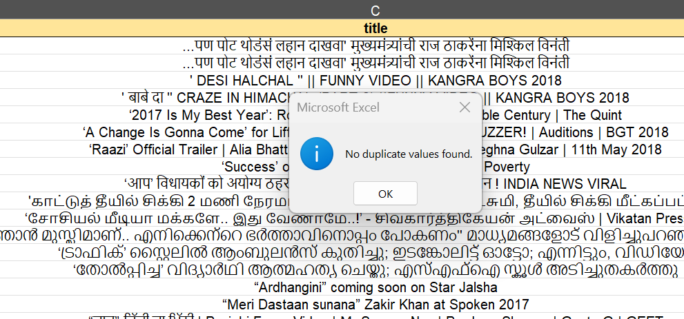
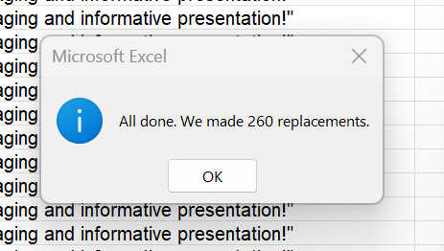
Q1
STEPS: TO REMOVE THE DUPLICATES
GO TO DATA TAB AND PRESS REMOVE DUPLICATE FUNCTION
INFERENCE:
IN THE GIVEN DATA NO DUPLICATES WERE FOUND
THE “COMMENTS SECTION “ IN THE DATASET CONTAINS MANY BLANK VALUES

Slide 3
Q2
STEPS:
TO FIND THE TIME BETWEEN PUBLISHING AND TRENDING SUBTRACT BOTH DATES
TO FIND AVERAGE TIME GAP TAKE THE AVERAGE OF THE TIME DIFFERENCE COLUMN USING AVERAGE FUCTION
FORMULA: AVERAGE(C:C)
INFERENCE:
THUS ON AN AVERAGE IT TAKES
2 DAYS TO THE VIDEO TO GET TREND.

Slide 4
Q3
STEPS: USE PIVOT TABLE AND FIND THE AVERAGE VIEWS FOR EACH CATEGORY , COUNT OF COMMENT AND COUNT OF LIKES
ENGAGEMENT RATE IS FOUND BY LIKES+COMMENTS/VIEW
FORMULA:
USED PIVOT TABLE
INFERENCE:
THUS MOVIES CATEGORY HAS THE HIGHEST NUMBER OF VIEWS

Slide 5
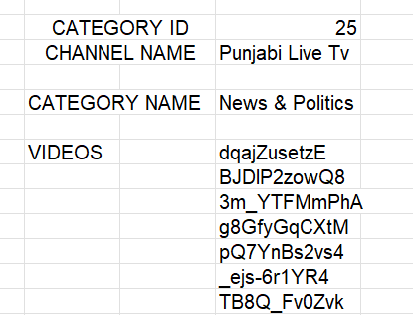
Q4
STEPS:
CREATE DROPDOWN FOR VARIOUS CATEGORY ID AND CHANNEL NAME USING DATA VALIDATION FUNCTION
USE XLOOKUP TO GET THE CATEGORY NAME USING CATEGORY ID
USE FILTER TO TAKE THE VIDEOS FOR PARTICULAR CHANNEL NAME.
FORMULA:
XLOOKUP(Sheet4!I3,Category!A:A,Category!B:B)
FILTER('YouTube data'!A:A,'YouTube data'!D:D=Sheet4!I4)

Slide 6
Q5
STEPS:
FORMULA:
INFERENCE:

Slide 7
Q6
STEPS:
FORMULA:
INFERENCE:

Slide 8
Q7
STEPS:HERE I AM TAKING EACH CATEGORY FOR ANALYSING THE KEY METRICS LIKE VIEWS,LIKES AND COMMENTS
FORMULA:
PIVOT TABLE IS USED
INFERENCE:
FROM THE DASHBOARD WE CAN CONFIRM THAT THE ENTERTAINMENT CATEGORY HAS THE HIGHEST NUMBER OF VIEWS, LIKES AND COUNTS

Slide 9
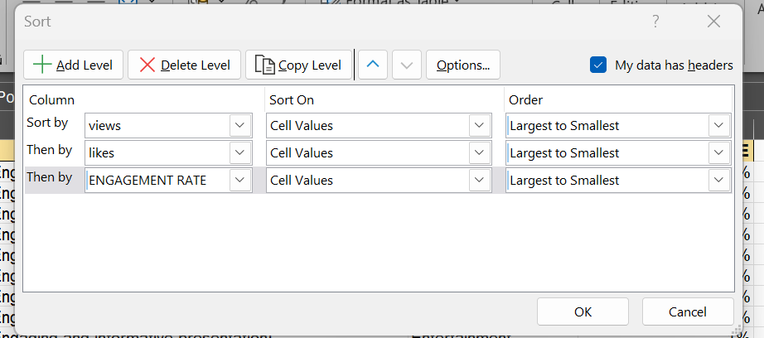
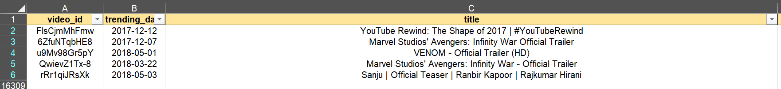
Q8
TOP 5
STEPS: HERE I HAVE CREATED AN COLUMN ENGAGEMENT RATE
THEN I HAVE USED CUSTOM SORT TO SORT THE DATA BASED ON VIEWS , LIKES AND ENGAGEMENT RATE RESPECTIVELY.
FORMULA: CUSTOM SORT FUNCTION
INFERENCE:
THUS “YouTube Rewind: The Shape of 2017 | #YouTubeRewind” STANDS TOP AT PERFORMING CATEGORY.

Slide 10
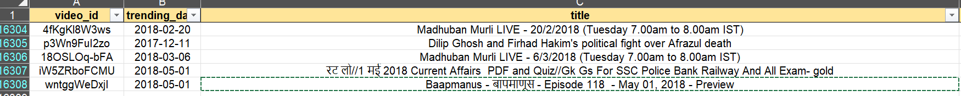
Q8
BOTTOM 5
STEPS:
HERE I HAVE CREATED AN COLUMN ENGAGEMENT RATE
THEN I HAVE USED CUSTOM SORT TO SORT THE DATA BASED ON VIEWS , LIKES AND ENGAGEMENT RATE RESPECTIVELY.
FORMULA: CUSTOM SORT FUNCTION
INFERENCE:
THUS Baapmanus - बापमाणूस - Episode 118 - May 01, 2018 - Preview STANDS LOW AT PERFORMING CATEGORY.

Slide 11
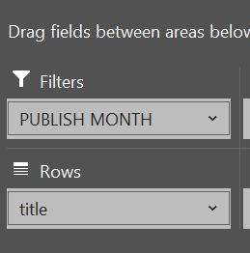
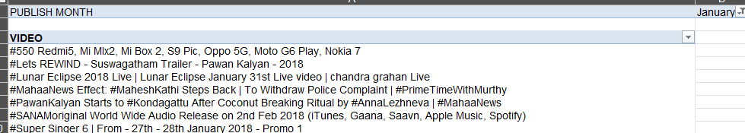
Q9
STEPS:HERE I AM TAKING PUBLISH MONTH AS A FILTER AND VIDEO AS ROW VALUE
FORMULA:
USED PIVOT
INFERENCE:
THUS WE CAN EASILY VIEW THE VIDEOS PUBLISHED IN A PARTICULAR MONTH USING FILTER
EXAMPLE SHOWN HERE IS “VIDEOS PUBLISHED IN JAN MONTH”

Slide 12
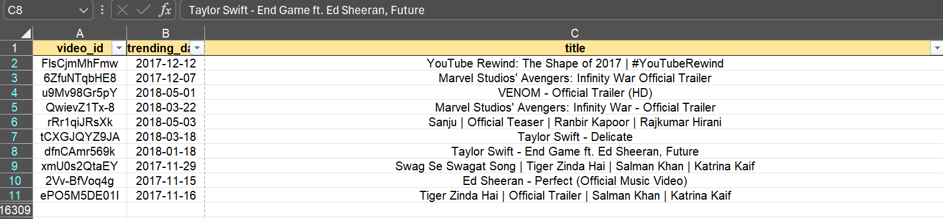
Q10
INFERENCE:
BASED ON THE GROWTH ANALYSIS WE CAN SEE THAT THE TOP PERFORMING VIDEO IS YouTube Rewind: The Shape of 2017 | #YouTubeRewind
STEPS:
I HAVE USED CUSTOM SORT AND SORTED BASED ON VIEWS AND LIKES
RESPECTIVELY

Slide 13
Q11
STEPS:
HERE I GROUPED THE VIDEOS BASED ON PUBLISHING DATE AND AND ANALYSED THE SUM OF VIEWS FOR THIS COHORT
FORMULA:
USED PIVOT TABLE
INFERENCE:
FROM THE ANALYSIS WE CAN CONCLUDE THAT THE VIDEOS PUBLISHED AT MARCH MONTH HAS REACHED THE MOST NUMBER OF VIEWS.

Slide 14
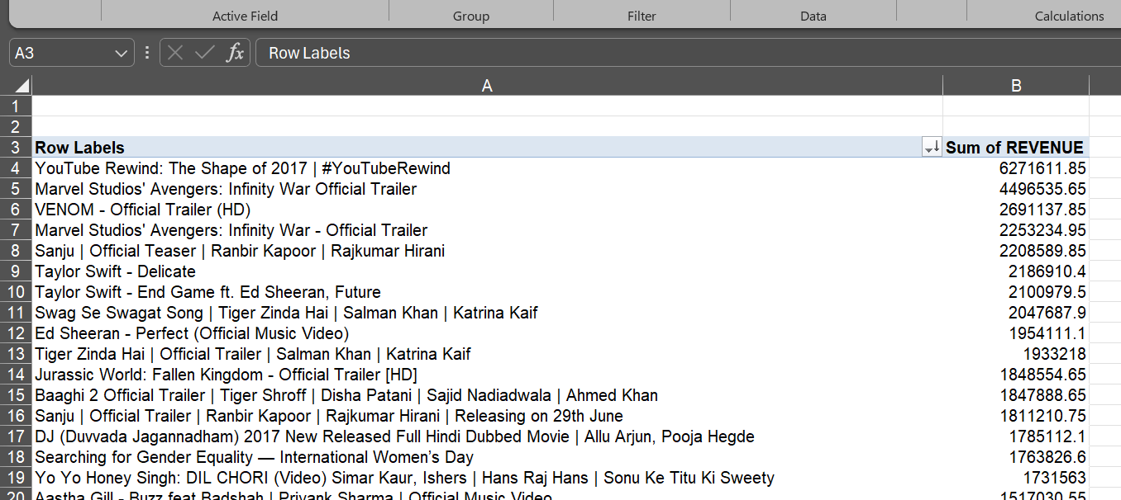
Q12
STEPS:
HERE I HAD ASSUMED THE REVENUE RATE IS 5%
USING THIS REVENUE WAS CALCULATED FOR EACH VIDEO
FORMULA:
USED PIVOT TABLE
INFERENCE:
BY THE ANALYSIS THE VIDEO”YouTube Rewind: The Shape of 2017 | #YouTubeRewind “
HAS THE HIGHEST REVENUE.

Slide 15
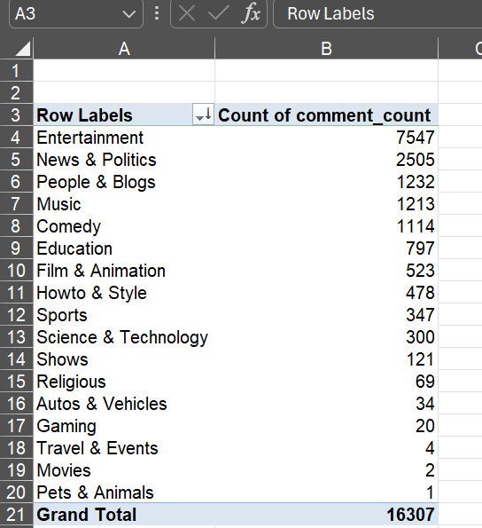
Q13
STEPS:
USED PIVOT TABLE TO KNOW THE COMMENT COUNT FOR EACH CATEGORY
FORMULA:
USED PIVOT TABLE
INFERENCE:
THUS BY ANALYSING WE CAN FIND THAT ENTERTAINMENT CATEGORY HAS THE HIGHEST COUNT OF COMMENTS AND PETS AND ANIMAL CATEGORY HAS THE LOWEST COUNT OF COMMENTS

Slide 16
Q14
STEPS:
HERE I HAD USED “VIEWS” AND “LIKES” AS ENGAGEMENT METRICS FOR VARIOUS CATEGORIES
FORMULA:
PIVOT TABLE
INFERENCE:
THUS “ENTERTAINMENT” IS MORE ENGAGING COMPARED TO OTHER CATEGORIES.

Slide 17
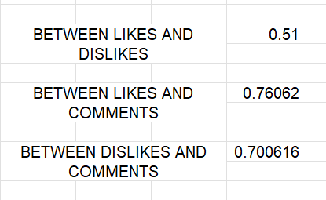
Q15
STEPS:
USING “CORREL” FUNCTION TO FIND THE CORRELATION
FORMULA:
CORREL(ARRAY1,ARRAY2)
INFERENCE:
FROM THE ANALYSIS WE CAN SAY THAT EVERY VALUES HAS AN POSITIVE CORRELATION(ABOVE 0)

Slide 18
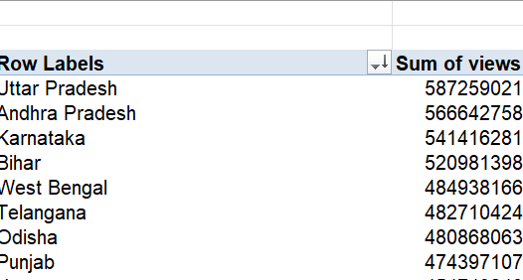
Q16
STEPS:
USED PIVOT TABLE
INFERENCE:
BY GROUPING THE VIEWS BY COUNTRY WE CAN SEE THAT “UTTAR PRADESH” HAS THE HIGHEST SUM OF VIEWS.

Slide 19
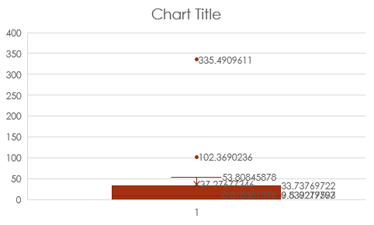
Q17
STEPS:
USED BOX AND WHISKAS CHART TO DETECT OUTLIER
INFERENCE:
FROM THIS WE CAN CONCLUDE THAT THERE ARE 3 OUTLIER VALUES IN ENGAGEMENT RATE LIKE SHOWN IN THE TABLE

Slide 20
Q18
STEPS:
USED PIVOT TABLE TO KNOW LIKES AND DISLIKES FOR EACH CHANNEL
INFERENCE:
WE CAN INFER THAT “PewDiePie”
HAS THE HIGHEST NUMBER OF LIKES AND LOWEST DISLIKES

Slide 21
Q19
STEPS:
FORMULA:
INFERENCE:
BASED ON THE ANALYSIS
WE CAN SEE THAT “YOUTUBE SPOTLIGHT “ HAS MORE VIEWS AND LIKES

Slide 22
20
STEPS:HERE I AM TAKING PUBLISH MONTH AS A FILTER AND VIDEO AS ROW VALUE
FORMULA:
USED PIVOT
INFERENCE:
THUS WE CAN EASILY VIEW THE VIDEOS PUBLISHED IN A PARTICULAR MONTH USING FILTER
EXAMPLE SHOWN HERE IS “VIDEOS PUBLISHED IN JAN MONTH”

